Slide 1
Introduction to Software Engineering
CSSE3113

Slide 2
Software Engineering
Solving problems that involve computing and computers?
Solving problems that involve computing and computers in a consistent/systematic manner?
A set of guidelines for solving the computing and computer related problems in a systematic manner?

Slide 3
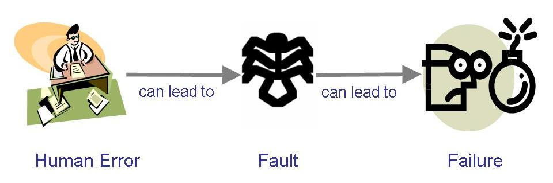
Sidebar: Terminology for Describing Bugs
A fault: occurs when a human makes a mistake, called an error, in performing some software activities
A failure: is a departure from the system’s required behaviour

Slide 4
Why is SE Needed?
Computers everywhere
Toaster, Microwave, Temperature control of A/C, Router, Surgical Equipment…
Computers need to be managed
Software runs on all computers
Make lives comfortable, efficient, effective…
SE practices ensure development of good software to improve our living standard

Slide 5
Why Do We Need to Study SE?
What could be the benefits?

Slide 6
What is a Good Software Product?
Good software engineering must always include a strategy for producing quality software
Product Quality?
Multiple facets…

Slide 7
What is a Good Software Product?
Users judge external characteristics (e.g., correct functionality, number of failures, type of failures)
Designers and maintainers judge internal characteristics (e.g., ease of modification)
Thus different stakeholders may have different criteria
Need quality models to relate the user’s external view to developer’s internal view

Slide 8
Continued..
Three Main Perspectives of the Quality Attributes of the Software:
A perspective is required for every approach. Be it, software niche or any other niche.
Product Operations
Correctness: The functionality should match the specification.
Reliability: The extent to which the system fails.
Efficiency: It enhances the usage of system resource.as well as the amount of computing resources and code required by a program to perform.
Integrity: this factor deals with software security, to prevent from unauthorized access
Usability: The software should be easy to use. Difficult software is tedious to work upon and difficulty irks the user.

Slide 9
Product Transition
Portability: This is the ability to transfer a software from one environment to another environment.(python, java)
Re-usability: The software components can be used in different contexts.
Interoperability: The ease or the comfort zone in which all the components of the software works together.
Product Revision
Maintainability: if there are defects in the software that are found in the later stage, this feature allows finding and fixing the defects.
Flexibility: The ability to make changes in the software product according to the business demands.
Testability: This enables the software product to validate the requirements.

Slide 10
What is a Good Software Product?
Traceability
Completeness
Consistency
Correctness
Accuracy
McCall’s Quality Model
Reliability
Error Tolerance
Execution Efficiency
Efficiency
Storage Efficiency
Access Control
Integrity
Access Audit
Usability
Operability
Training
Maintainability
Communicativeness
Simplicity
Testability
Conciseness
Flexibility
Instrumentation
Self-descriptiveness
Portability
Expandability
Generality
Reusability
Modularity
Interoperability
Software System Independence
Machine Independence
Communications Commonality
Data Commonality

Slide 11
Quality of Process
Quality of the development and maintenance process is as important as the product quality
The development process needs to be modeled
Modeling will address questions such as
Where to find a particular kind of fault
How to find faults early
How to build in fault tolerance
What are alternative activities
Models for process improvement
SEI’s Capability Maturity Model (CMM):5 levels( initial, repeatable, defined, manged ,optimizing)
ISO 9000
Software Process Improvement and Capability determination (SPICE)

Slide 12
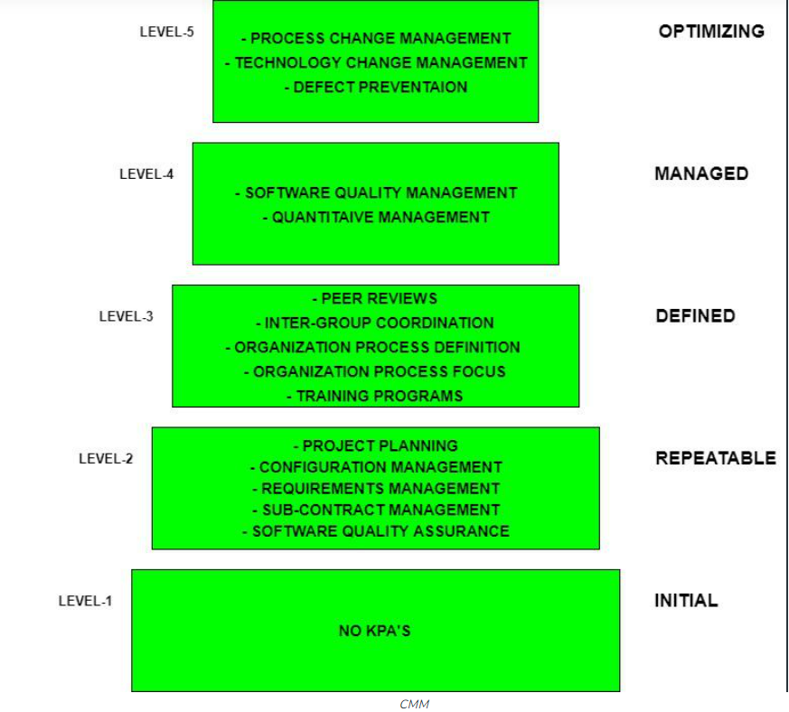
Capability maturity model

Slide 13
CMM continued….
Level-1: Initial
No Key Process Areas defined.
Processes followed are Adhoc and immature and are not well defined.
Unstable environment for software development.
No basis for predicting product quality, time for completion, etc.
Limited project management capabilities, such as no systematic tracking of schedules, budgets, or progress.
We have limited communication and coordination among team members and stakeholders.
No formal training or orientation for new team members.
Little or no use of software development tools or automation.
Highly dependent on individual skills and knowledge rather than standardized processes.
High risk of project failure or delays due to a lack of process control and stability.

Slide 14
CMM continued….
Level-2: Repeatable
Focuses on establishing basic project management policies.
Experience with earlier projects is used for managing new similar-natured projects.
Project Planning- It includes defining resources required, goals, constraints, etc. for the project. It presents a detailed plan to be followed systematically for the successful completion of good-quality software.
Configuration Management- The focus is on maintaining the performance of the software product , including all its components, for the entire lifecycle.
Requirements Management- It includes the management of customer reviews and feedback which result in some changes in the requirement set. It also consists of accommodation of those modified requirements.
Subcontract Management- It focuses on the effective management of qualified software contractors i.e. it manages the parts of the software developed by third parties.
Software Quality Assurance- It guarantees a good quality software product by following certain rules and quality standard guidelines while developing.

Slide 15
CMM continued….
Level-3: Defined
At this level, documentation of the standard guidelines and procedures takes place.
It is a well-defined integrated set of project-specific software engineering and management processes.
Peer Reviews: In this method, defects are removed by using a number of review methods like walkthroughs, inspections, buddy checks, etc.
Intergroup Coordination: It consists of planned interactions between different development teams to ensure efficient and proper fulfillment of customer needs.
Organization Process Definition: Its key focus is on the development and maintenance of standard development processes.
Organization Process Focus: It includes activities and practices that should be followed to improve the process capabilities of an organization.
Training Programs: It focuses on the enhancement of knowledge and skills of the team members including the developers and ensuring an increase in work efficiency.

Slide 16
CMM continued….
Level-4: Managed
At this stage, quantitative quality goals are set for the organization for software products as well as software processes.
The measurements made help the organization to predict the product and process quality within some limits defined quantitatively.
Software Quality Management: It includes the establishment of plans and strategies to develop quantitative analysis and understanding of the product’s quality.
Quantitative Management: It focuses on controlling the project performance in a quantitative manner.

Slide 17
CMM continued….
Level-5: Optimizing
This is the highest level of process maturity in CMM and focuses on continuous process improvement in the organization using quantitative feedback.
The use of new tools, techniques, and evaluation of software processes is done to prevent the recurrence of known defects.
Process Change Management: Its focus is on the continuous improvement of the organization’s software processes to improve productivity, quality, and cycle time for the software product.
Technology Change Management: It consists of the identification and use of new technologies to improve product quality and decrease product development time.
Defect Prevention It focuses on the identification of causes of defects and prevents them from recurring in future projects by improving project-defined processes.

Slide 18
Quality in Context of Business Environment
Business value is as important as technical value
Business value (in relationship to technical value) must be quantified
A common approach: return on investment (ROI) – what is given up for other purposes
ROI is interpreted in different terms: reducing costs, predicting savings, improving productivity, and costs (efforts and resources)

Slide 19
How Successful Have We Been
Perform tasks more quickly and effectively
Word processing, spreadsheets, e-mail
Support advances in medicine, agriculture, transportation, multimedia education, and most other industries
Many good stories
However, software is not without problems

Slide 20
How Successful Have We Been
IRS hired Sperry Corporation to build an automated federal income tax form processing system
An extra $90 M was needed to enhance the original $103 product
IRS lost $40.2 M on interests and $22.3 M in overtime wages because refunds were not returned on time
Malfunctioning code in Therac-25 killed several people (Therac 25 - The Million Dollar Killing Machine – YouTube)
Reliability constraints have caused cancellation of many safety critical systems
Safety-critical: something whose failure poses a threat to life or health

Slide 21
Who Does Software Engineering?
Customer: the company, organization, or person who pays for the software system
Developer: the company, organization, or person who is building the software system
User: the person or people who will actually use the system

Slide 22
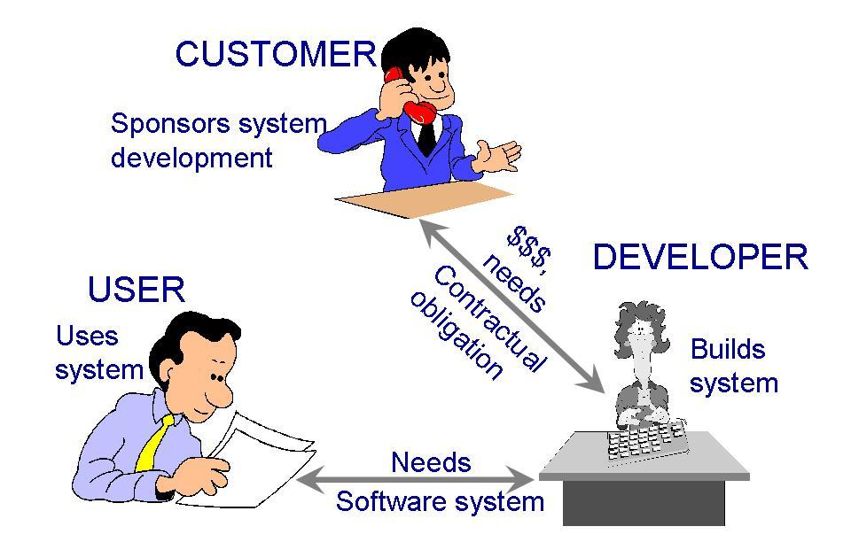
Who Does Software Engineering?
Participants (stakeholders) in a software development project
Common Of The Shelf (COTS)
Sub-contractors
Turnkey System
Notes:
Commercial-off-the-shelf (COTS) software is a term in software engineering for ready-made, commercial products.
A subcontractor is a person or business that undertakes to perform part or all of the obligations of another's contract.
A turnkey solution is a type of system built end-to-end for a customer that can be easily implemented into a current business process.

Slide 23
A Systems Approach
Hardware/Software
People
Interactions

Slide 24
A Systems Approach (Contd.)
Objects
i.e. things
Activities
Actions taken
Input / Outputs
Relationships for example:
Which object performs what activities
Which objects are associated with other objects
System Boundary
Who generates input and who receives output
Which objects/activities are part of the system and which are not
Nested systems, related systems, interrelated systems

Slide 25
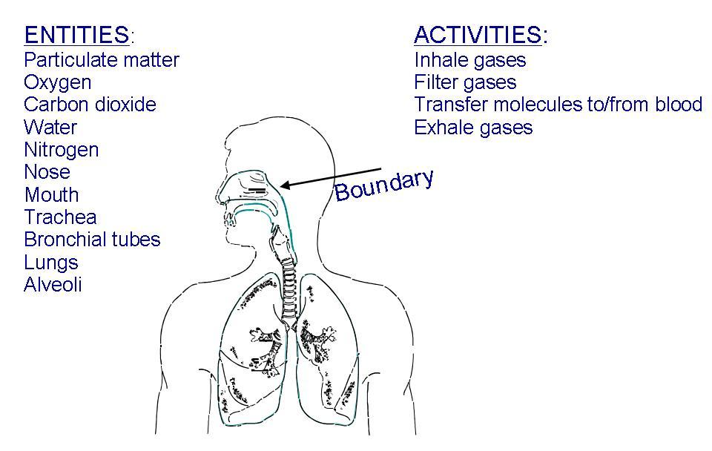
A Systems Approach (Contd.)
Example of systems: a human respiratory system
??

Slide 26
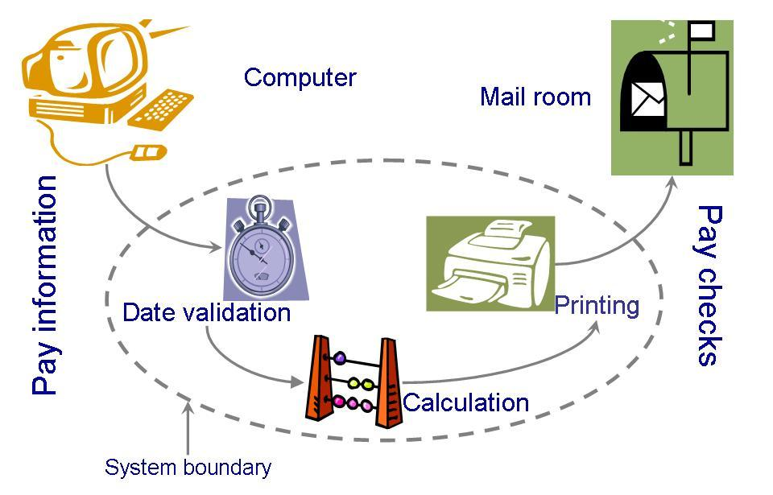
A Systems Approach (Contd.)
A computer system must also be clearly described: System definition of a paycheck production

Slide 27
A Systems Approach (Contd.)
Interrelated Systems:
Some systems are dependent to other systems
The interdependencies may be complex
It is possible for one system to exist inside another system
If the boundary definitions are detailed, building a larger system from the smaller ones is relatively easy

Slide 28
Lecture 3

Slide 29
An Engineering Approach
Idea to build a house
Asking someone to build the house
Explaining requirements
Getting designs
Modifying + Approving designs
Inspecting the construction
Adding new features
Testing household components
Moving in
Getting issues fixed after moving in
Building a House

Slide 30
An Engineering Approach
Determine and Analyze Requirements
Produce and Document Overall Design
Produce Detailed Specifications
Identify and Design Components
Build Components
Test Components
Integrate Components
Make final modifications after residents move in
Continue Maintenance by the Residents
Building a House

Slide 31
An Engineering Approach
Requirement analysis and definition
System design
Program design
Writing the programs
Unit testing
Integration testing
System testing
System delivery
Maintenance
Building a System

Slide 32
Development Team
Requirement analysts: work with the customers to identify and document the requirements
Designers: generate a system-level description of what the system is supposed to do
Programmers: write lines of code to implement the design
Testers: catch faults
Trainers: show users how to use the system
Maintenance team: fix faults that show up later
Librarians: prepare and store documents such as software requirements
Configuration management team: maintain correspondence among various artefacts

Slide 33
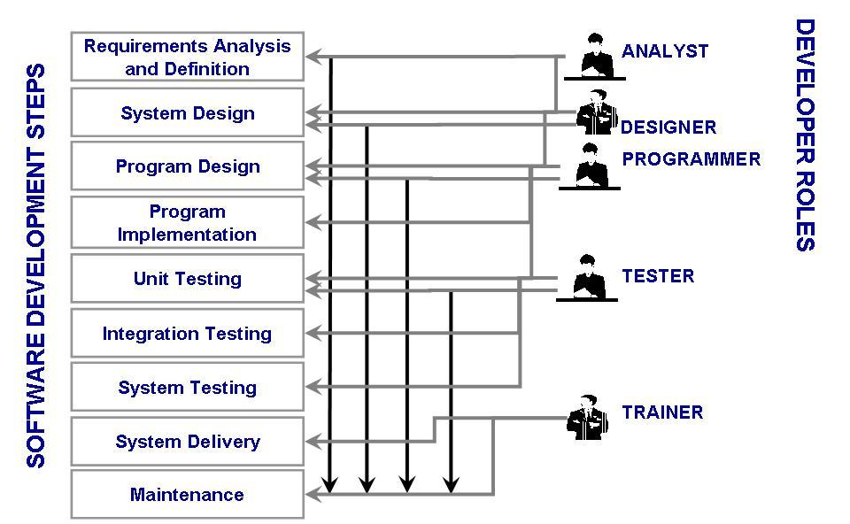
Development Team (Roles)
Who Does What?

Slide 34
How has SE Changed?
Before 1970s
Single processors: mainframes
Designed in one of two ways
as a transformation: input was converted to output
as a transaction: input determined which function should be performed
After 1970s
Run on multiple systems
Perform multi-functions

Slide 35
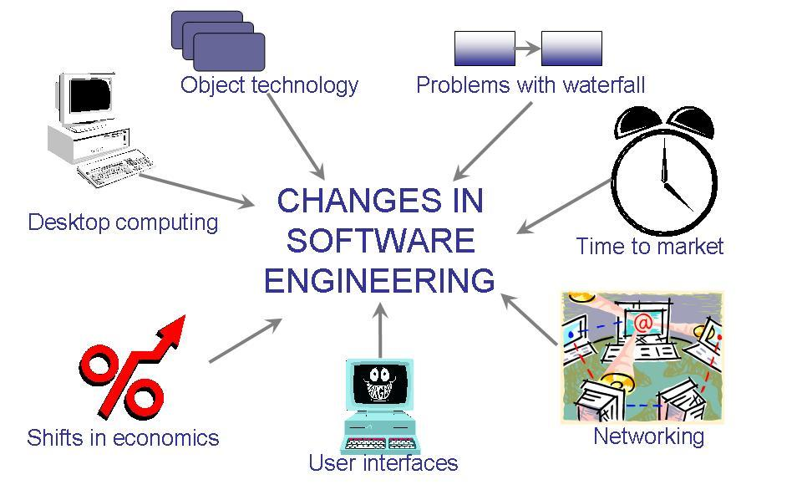
How has SE Changed? (Contd.)
The key factors that have changed the software development
Wasserman’s View

Slide 36
How has SE Changed? (Contd.)
Abstractions
Analysis and design methods and notations
User interface prototyping
Software architecture
Software process
Reuse
Measurement
Tools and integrated environments
Wasserman’s Discipline of Software Engineering

Slide 37
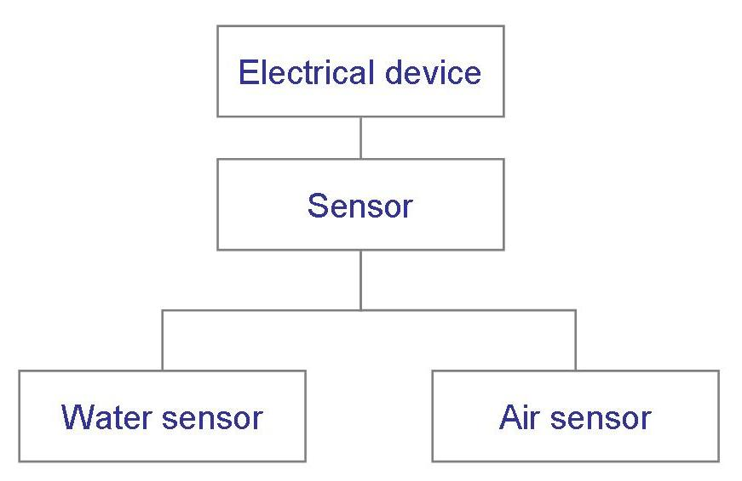
How has SE Changed? (Contd.) Wasserman’s Discipline
Abstractions
Hide details
A description of the problem at some level of generalization

Slide 38
How has SE Changed? (Contd.) Wasserman’s Discipline
Analysis and Design Methods and Notations
Provide documentation
Facilitate communication
Offer multiple views
Unify different views

Slide 39
How has SE Changed? (Contd.) Wasserman’s Discipline
User Interface Prototyping
Prototyping: building a small version of a system
Help users identify key requirements of a system
Demonstrate feasibility
Develop good user interface

Slide 40
How has SE Changed? (Contd.) Wasserman’s Discipline
Software Architecture
A system’s architecture describes the system in terms of a set of architectural units and relationships between these units
Architectural decomposition techniques
Modular decomposition
Data-oriented decomposition
Event-driven decomposition
Outside-in-design decomposition
Object-oriented decomposition

Slide 41
How has SE Changed? (Contd.) Wasserman’s Discipline
Software Process
Many variations
Different types of software need different processes
Enterprise-wide applications need a great deal of control
Departmental applications can take advantage of rapid development

Slide 42
How has SE Changed? (Contd.) Wasserman’s Discipline
Software Reuse
Commonalities between applications may allow reusing artefacts from previous developments
Improve productivity
Reduce costs
Potential concerns
It may be faster to build a smaller application than searching for reusable components
Generalized components take more time to build
Must clarify who will be responsible for maintaining reusable components
Generality vs specificity: always a conflict

Slide 43
How has SE Changed? (Contd.) Wasserman’s Discipline
Tools and Integrated Environments
Platform integration (on heterogeneous networks)
Presentation integration (commonality of user interface)
Process integration (linking tools and the development process)
Data integration (to share common data)
Control integration (the ability of one tool to initiate action in another one)

Slide 44
Real Time Example
Ariane-4 rocket, from the European Space Agency
June 4, 1996: functioned well for 40 seconds, then veered off course and was destroyed
Contained four satellites: cost was $500 million
Reused code from Ariane-3 rocket

Slide 45
Real Time Example Ariane-4 Definition of Quality
From the Lions et al report:
“… demonstrated the high quality of the Ariane-4 programme as regards engineering work in general and completeness and traceability of documents.”
“… the supplier of the SRI … was only following the specification given to it. … The exception which occurred was not due to random failure but a design error.”

Slide 46
What this Chapter Means for You
Given a problem to solve
Analyze it
Synthesize a solution
Understand that requirements may change
Must view quality from several different perspectives
Use fundamental software engineering concepts (e.g., abstractions and measurements)
Keep system boundary in mind

Slide 47
Special THANK FOR THE MATERIALS
Mr. Haroon Abdul Waheed
Engr. Sajid Saleem
Pfleeger’s Book slides from UCF
Software Fundamentals

